Slide 1
Chiba Campaign 2020 Daily Report : Tropospheric NO₂ 2020/12/01
Irie Laboratory Saito Hikaru(齊藤 輝)

Slide 2
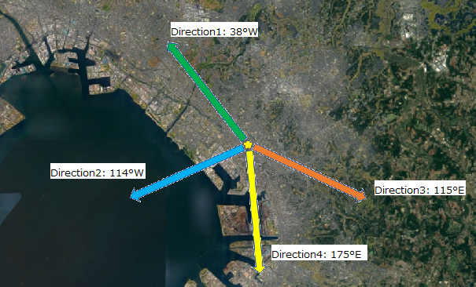
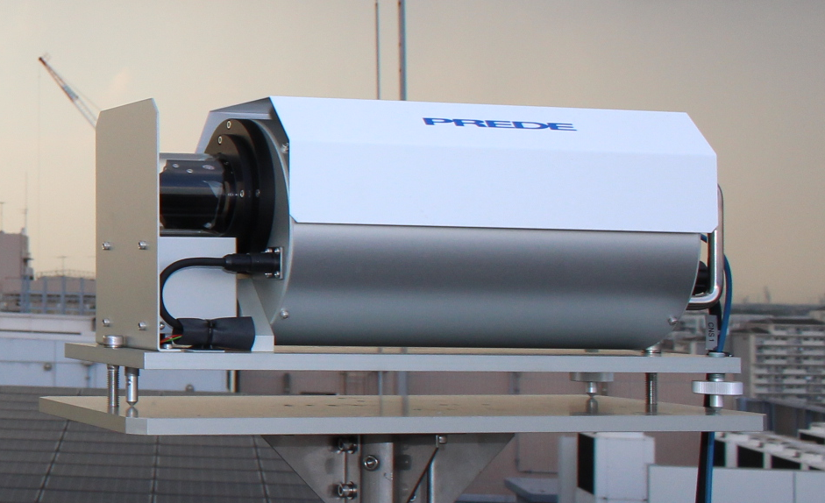
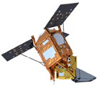
Tropospheric NO₂ column density data
4AZ-MAXDOAS (Ground-based)
Plot…
・All measurements
・Daily average
TROPOMI (TROPOspheric Monitoring Instrument) (Satellite-based)
Plot…
・Daily 0.2°×0.2° average
1995
2002
2004
20km

Slide 3
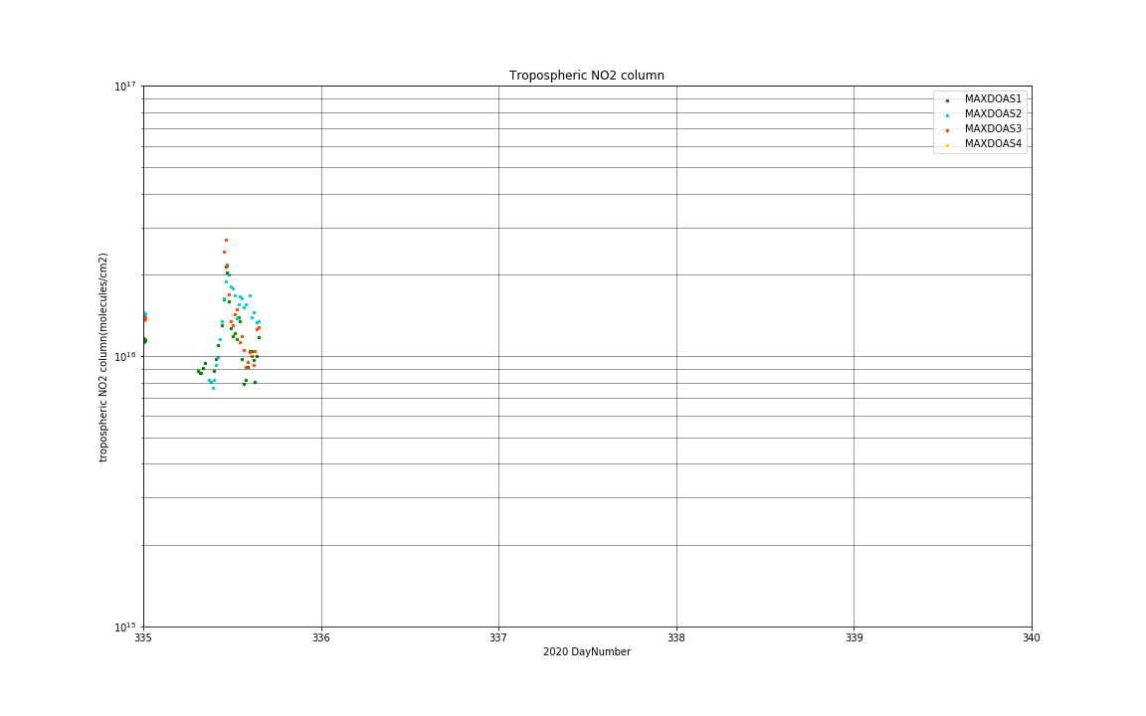
1995
2002
2004
20km

